Slide 1

Predicting Customer Churn for a Telecommunication Operator

Slide 2





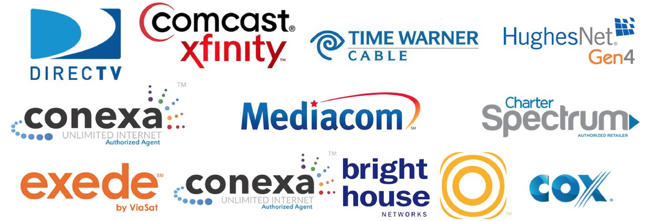
Telecommunication company
02
Notes:
Customer churn refers to when a customer (subscriber) ceases his or her relationship with a company

Slide 3


Challenges in the telecommunication industry IoT: The traffic explosion Decrease in voice revenue Security: The network is the threat Network congestion and Optimization Customer Churn in Telecommunication
Notes:
Lightting

Slide 4


Why study Customer churn?

Slide 5
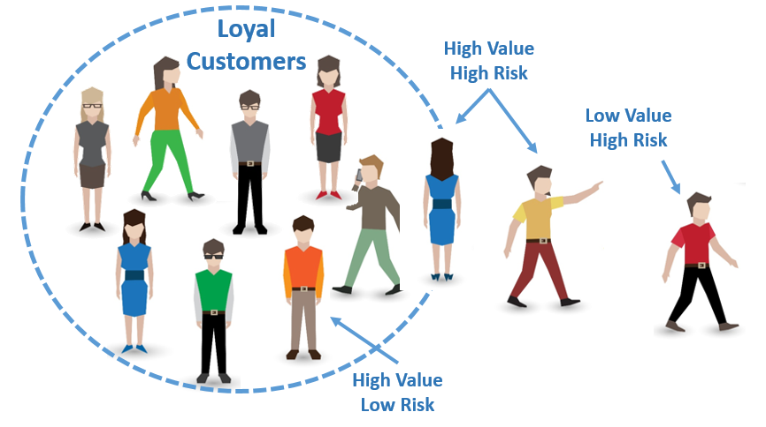
Why Study Customer Churn?
Losing customers is the BIGGEST problem that businesses face
It costs 5x - 25x as much to find a new customer than it does to retain
an existing customer .
Assuming:
It costs the company $500 to find a new customer
It costs the company $100 to retain an existing customer
“Customer looking for better service”

Slide 6
Objectives To Analyze customer data and develop predict customer retention programs." [IBM Sample Data Sets] from Kaggle Target Variable Churn (Yes / No)

Slide 7
Dataset cleaning and Analysis

Slide 8


Slide 9
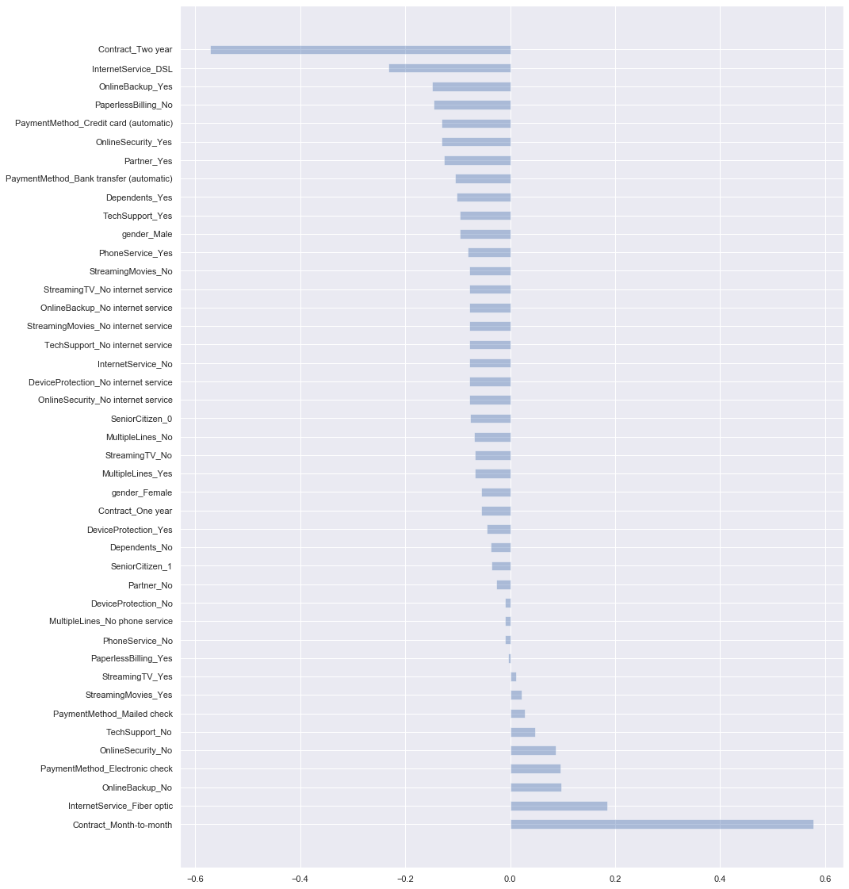




Brands Turn to Video for Content Marketing
Source: HubSpot

Slide 10
All these results together give us an important tool when the company
wants to decide which clients to focus their resources to try to avoid
them leaving ,
High Risk customers from the result:
contract_month_to_month customers
internetService_fiber optic customers
Tenure_low : Low tenure customers
totalcharges _low : customer with low totalcharges
And so on…….
0

Slide 11


On Behalf Of My Family
MerryXmas&HappyNewYear

Slide 12
Thank You!

